Slide 1

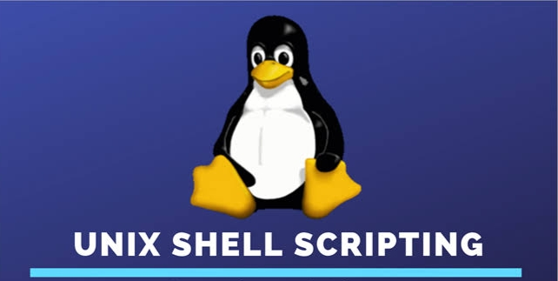

Slide 2
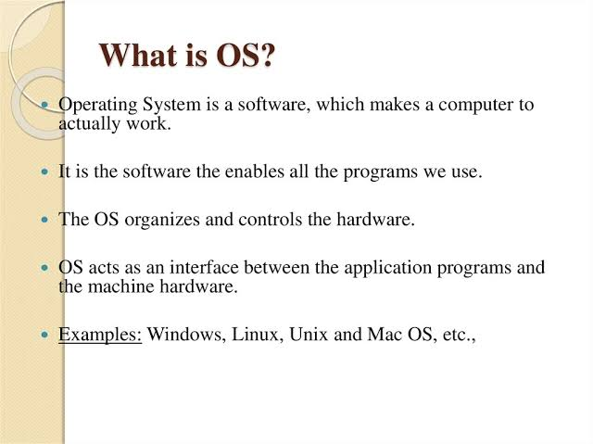

Slide 3
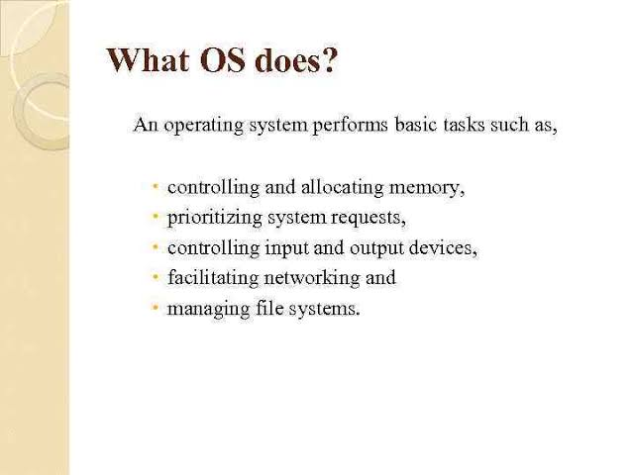

Slide 4
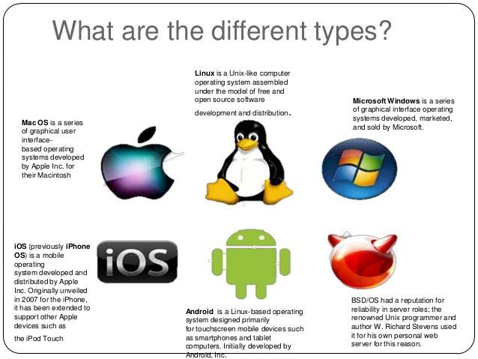

Slide 5


Slide 6


Slide 7
Unix
Unix is also an operating system like Linux. It is an commercial OS.
It consists of three parts: Kernal, Shell and Programs.
Most of the Unix and Linux commands are similar in nature.
Users communicate with the kernel through a program known as the shell.
The shell is a command line interpreter; it translates commands entered by the user and converts them into a language that is understood by the kernel.

Slide 8
Linux
Linux is an open-source operating system like other operating systems such as Microsoft Windows, Apple Mac OS, iOS, Google android, etc.
Linux is around us since the mid-90s.
It can be used from wristwatches to supercomputers.
It is everywhere in our phones, laptops, PCs, cars and even in refrigerators.
It is very much famous among developers and normal computer users.

Slide 9
Language used to develop Unix & Linux
The very first version of Unix was written in Assembly Language in the year 1969 and it was not until 1972 that Unix was rewritten in C (K&R C to be precise), with some parts still in Assembly.
The reason for the persistent Assembly code was not the inability of C but the inability of machines and compilers of that time; compilers were bad at optimization and even a mini-second gained by using Assembly meant a thing.

Slide 10
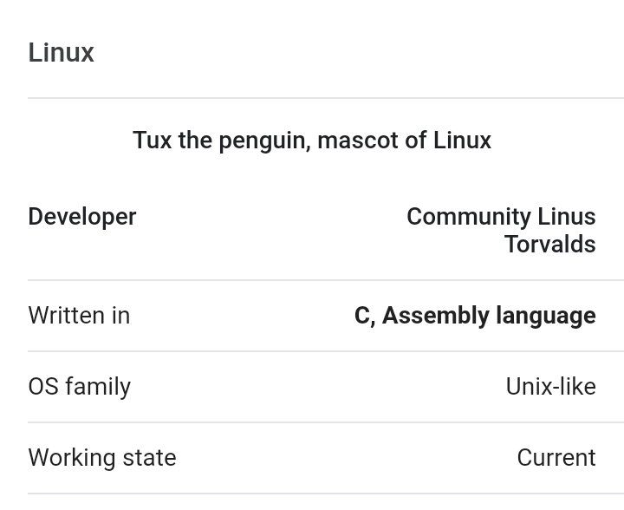

Slide 11
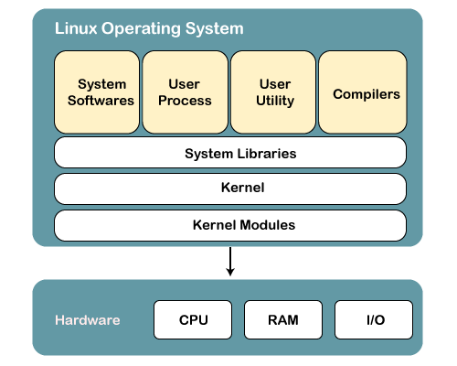

Slide 12
Why use Linux?
Linux may be a perfect operating system if you want to get rid of viruses, malware, slowdowns, crashes, costly repairs, and many more.
Further, it provides various advantages over other operating systems, and we don't have to pay for it.
Favorable choice of Developers
A flexible operating system

Slide 13
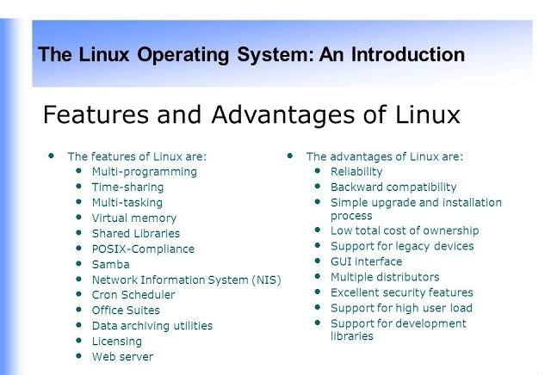

Slide 14
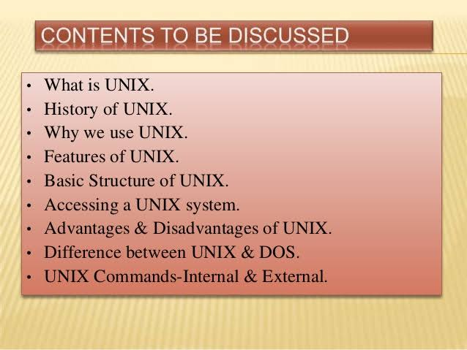

Slide 15
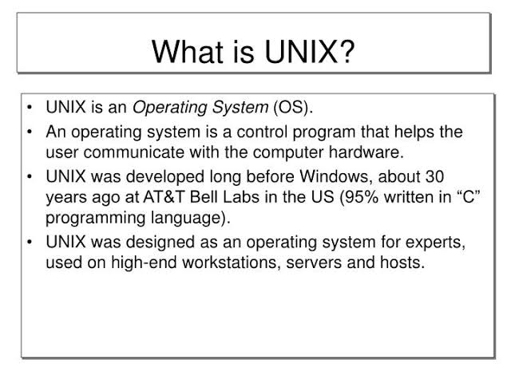

Slide 16
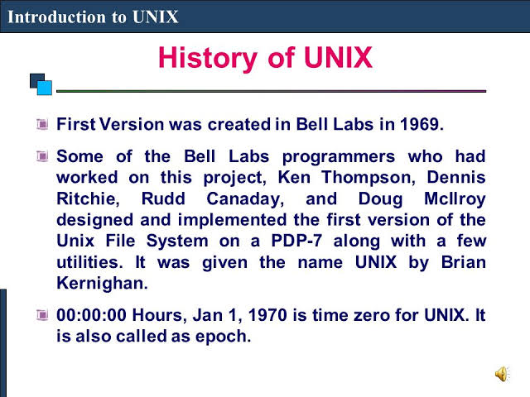

Slide 17
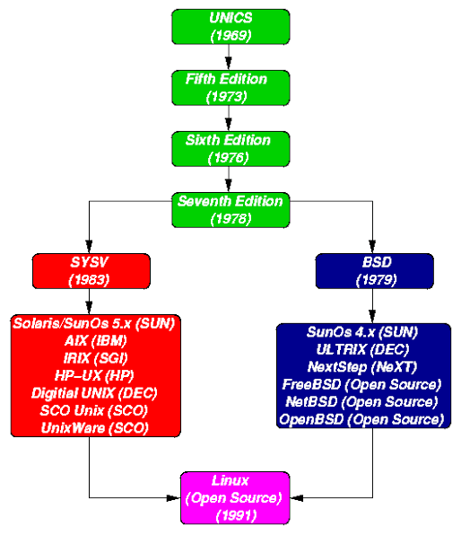

Slide 18
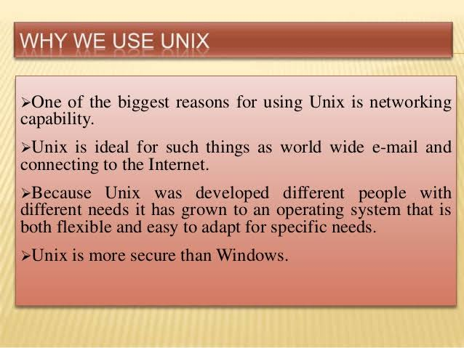

Slide 19
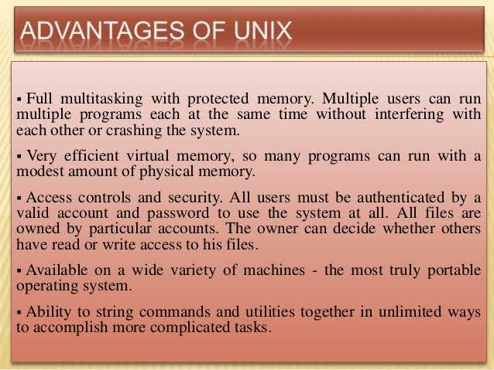

Slide 20
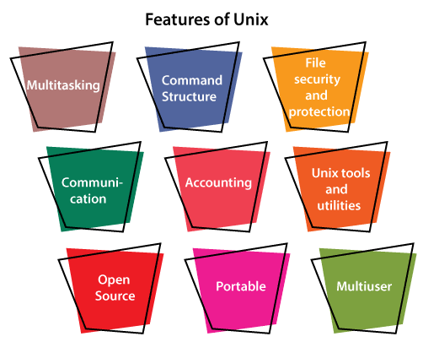

Slide 21
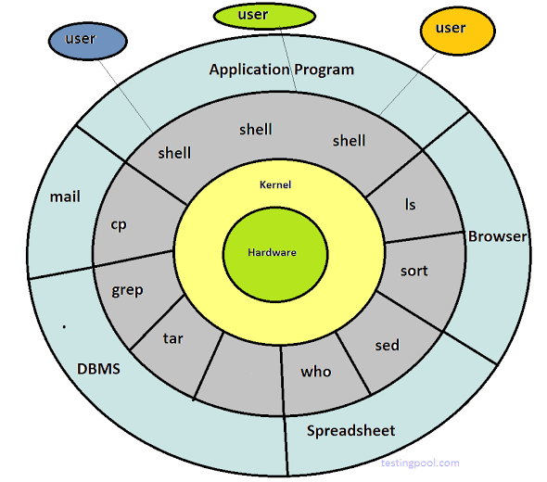


Slide 23
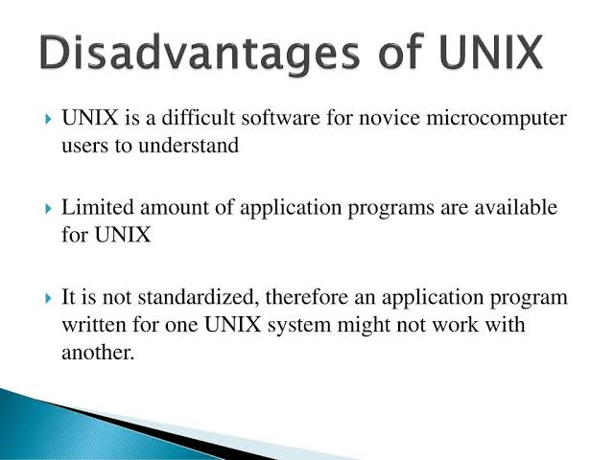

Slide 24


Slide 25
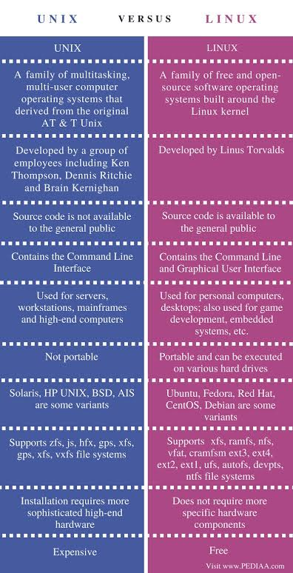

Slide 26
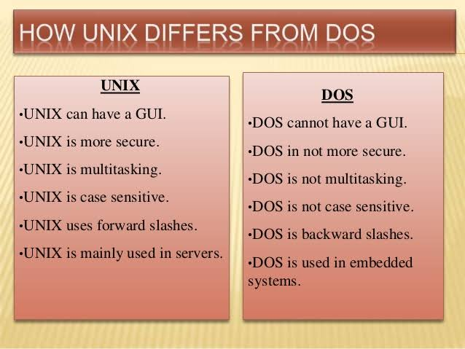

Slide 27
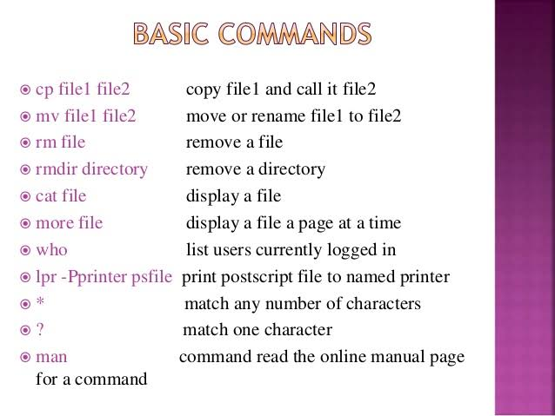

Slide 28
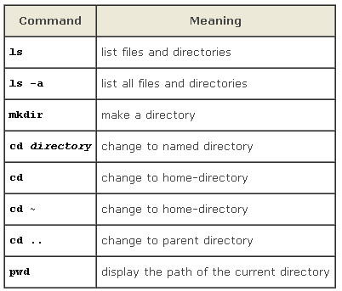

Slide 29
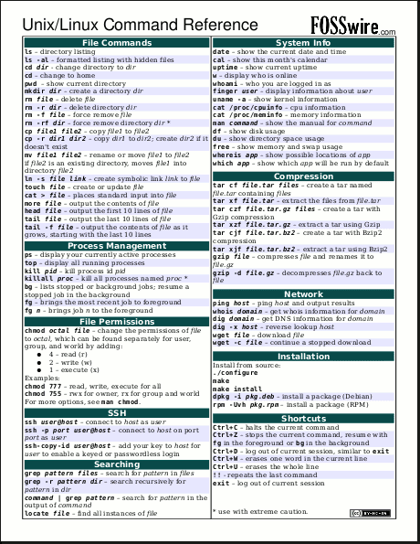

Slide 30
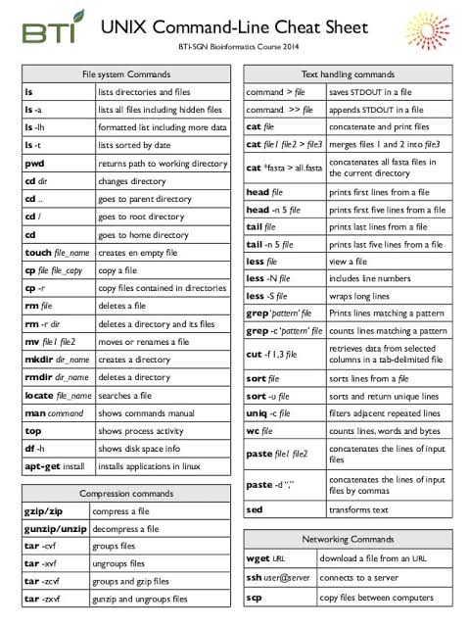

Slide 31
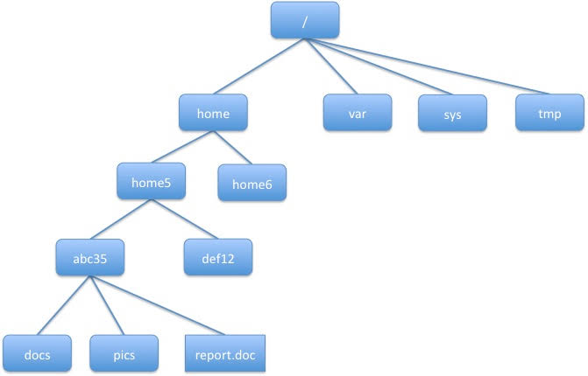

Slide 32
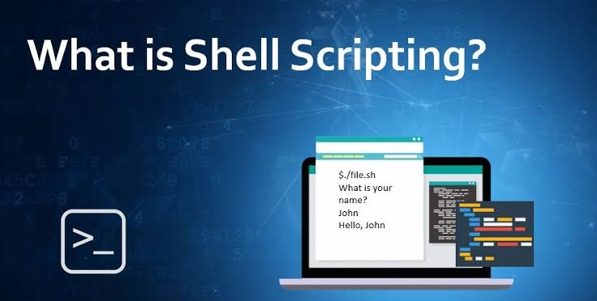

Slide 33
A shell script is a computer program designed to be run by the Unix/Linux shell which could be one of the following:
The Bourne Shell
The C Shell
The Korn Shell
The GNU Bourne-Again Shell
A shell is a command-line interpreter and typical operations performed by shell scripts include file manipulation, program execution, and printing text.

Slide 34
The shell is, after all, a real programming language, complete with variables, control structures, and so forth.
No matter how complicated a script gets, it is still just a list of commands executed sequentially.

Slide 35
# Script follows here:
echo "What is your name?"
read PERSON
echo "Hello, $PERSON"
sample run of the script −
$./test.sh
What is your name?
Zara Ali
Hello, Zara Ali
$

Slide 36
What is Shells?
A Shell provides you with an interface to the Unix system.
It gathers input from you and executes programs based on that input.
When a program finishes executing, it displays that program's output.
Shell is an environment in which we can run our commands, programs, and shell scripts.
There are different flavors of a shell, just as there are different flavors of operating systems.
Each flavor of shell has its own set of recognized commands and functions.

Slide 37
Using Shell Variables
Variable Names
The name of a variable can contain only letters (a to z or A to Z), numbers ( 0 to 9) or the underscore character ( _).
By convention, Unix shell variables will have their names in UPPERCASE
NAME="Zara Ali"
echo $NAME
The above script will produce the following value −
Zara Ali

Slide 38
Special Variables

Slide 39
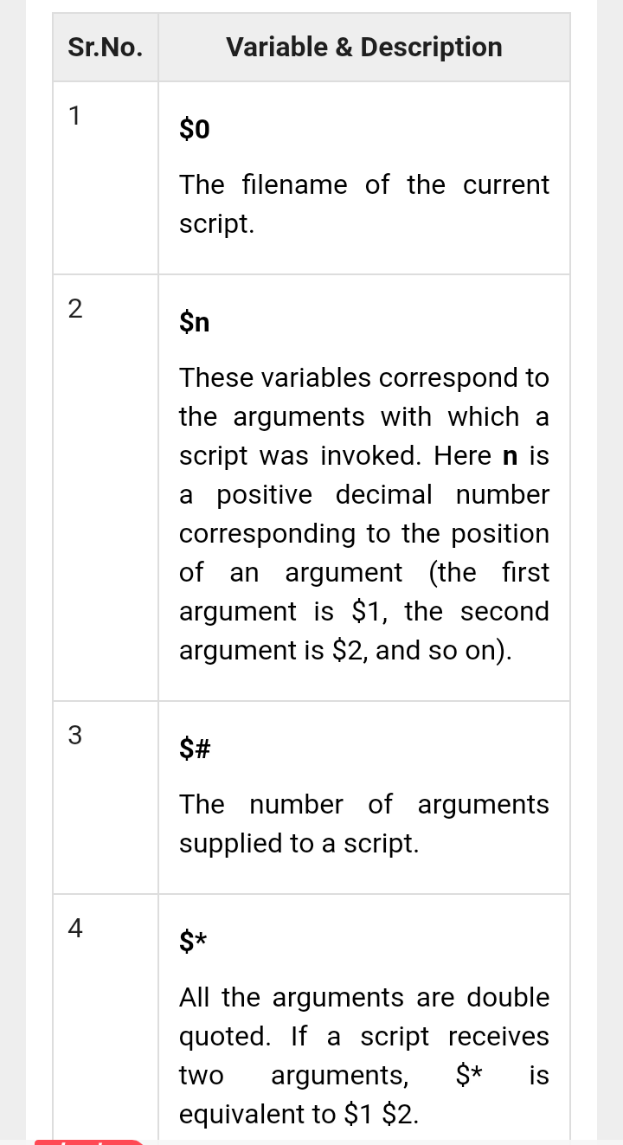

Slide 40
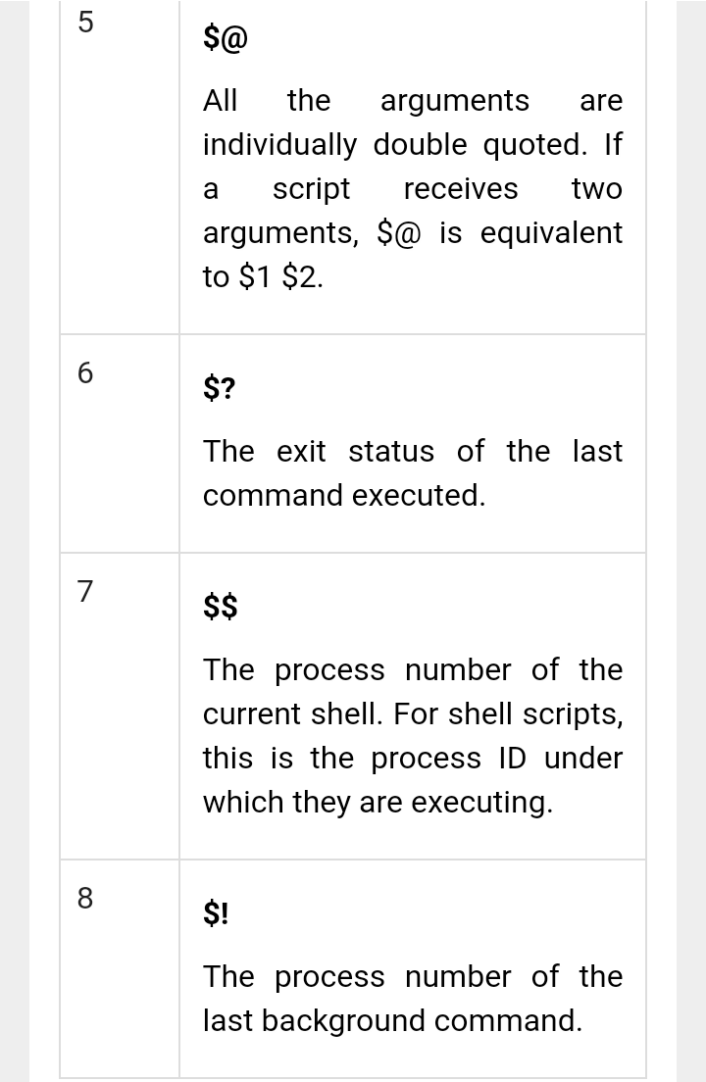

Slide 41
#!/bin/sh
echo "File Name: $0"
echo "First Parameter : $1"
echo "Second Parameter : $2"
echo "Quoted Values: $@"
echo "Quoted Values: $*"
echo "Total Number of Parameters : $#"
sample run for the above script −
$./test.sh Zara Ali
File Name : ./test.sh
First Parameter : Zara
Second Parameter : Ali
Quoted Values: Zara Ali
Quoted Values: Zara Ali
Total Number of Parameters : 2

Slide 42
Using Shell Arrays

Slide 43
Shell supports a different type of variable called an array variable. This can hold multiple values at the same time.
Arrays provide a method of grouping a set of variables. Instead of creating a new name for each variable that is required, you can use a single array variable that stores all the other variables.
All the naming rules discussed for Shell Variables would be applicable while naming arrays.

Slide 44
NAME[0]="Zara"
NAME[1]="Qadir"
NAME[2]="Mahnaz"
NAME[3]="Ayan"
NAME[4]="Daisy"
echo "First Index: ${NAME[0]}"
echo "Second Index: ${NAME[1]}"
$./test.sh
First Index: Zara
Second Index: Qadir

Slide 45
#!/bin/sh
NAME[0]="Zara"
NAME[1]="Qadir"
NAME[2]="Mahnaz"
NAME[3]="Ayan"
NAME[4]="Daisy"
echo "First Method: ${NAME[*]}"
echo "Second Method: ${NAME[@]}"
$./test.sh
First Method: Zara Qadir Mahnaz Ayan Daisy
Second Method: Zara Qadir Mahnaz

Slide 46
Shell Basic Operators
There are various operators supported by each shell.
Basic operators
Arithmetic Operators
Relational Operators
Boolean Operators
String Operators
File Test Operators

Slide 47
#!/bin/sh
val=`expr 2 + 2`
echo "Total value : $val"
Total value : 4

Slide 48
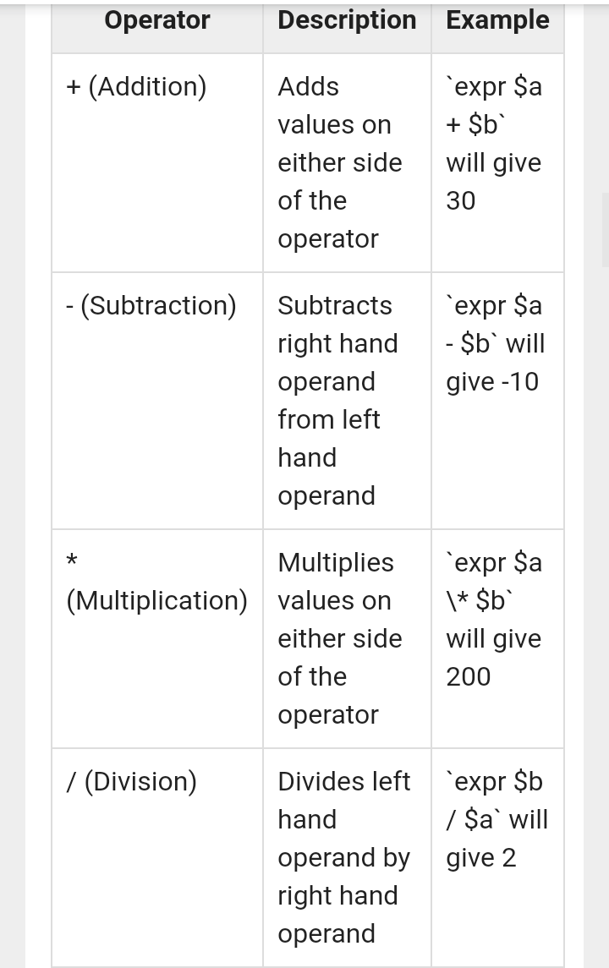

Slide 49
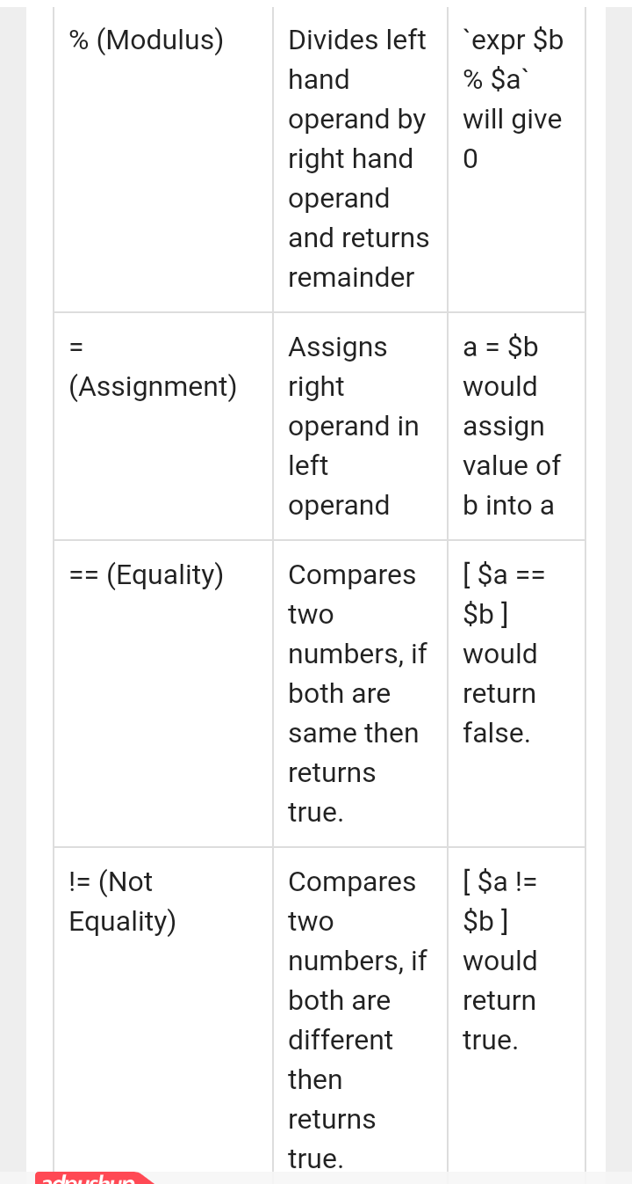

Slide 50
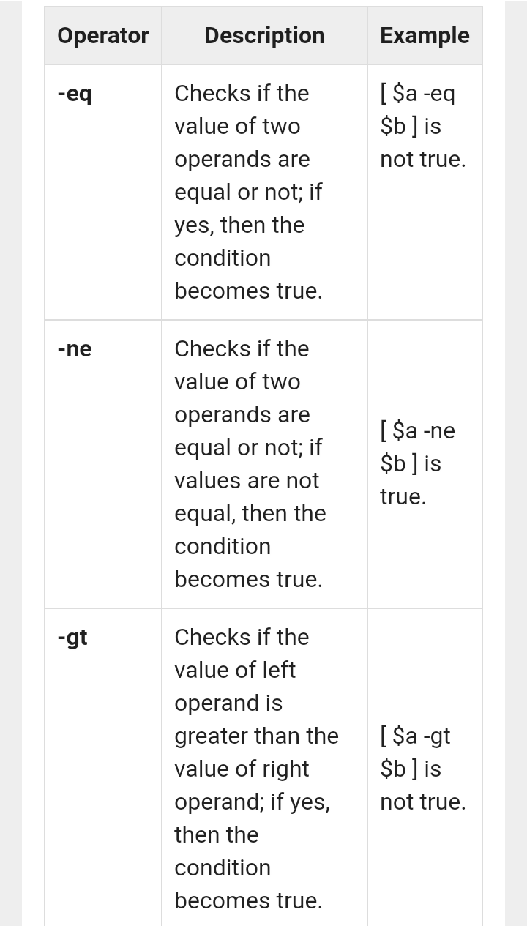

Slide 51
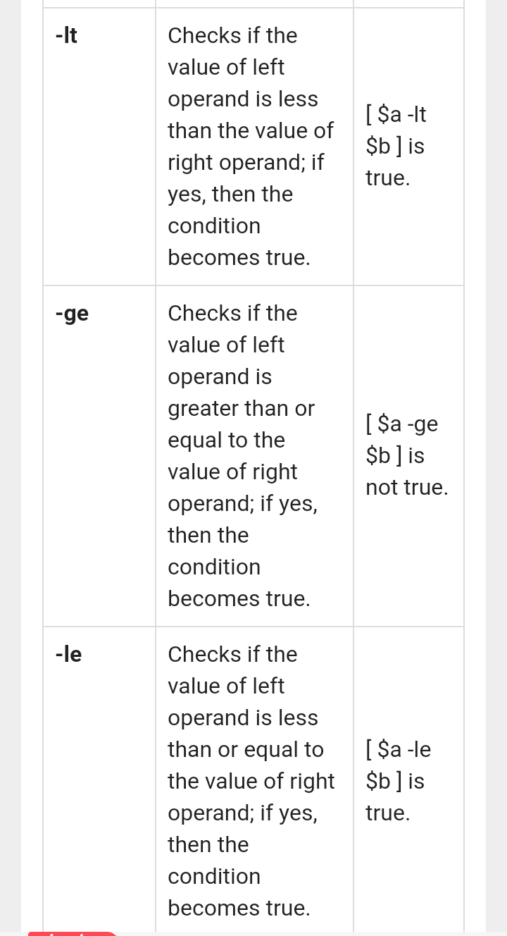

Slide 52
